Slide 1
Studying
SCOTUS
Using Supervised Learning Models
to Predict How the Supreme Court Justices of the United States will Vote
By Michelle Griffith

Slide 2
Data:
Supreme Court Database
Model Types:
Classifiers
Purpose:
Predict the lean of current US Supreme
Court Justice votes (Conservative or Liberal)
Intended Audience For This Presentation:
Those Familiar with Supervised Learning Models and related Terminology
Notes:
FIRST a little basis of the model
Data is from the supreme court database that has documented extensive information about every case ever argued at the Supreme Court
Dataset was pared down to include only our current supreme court justices
We’ll touch soon on the difference between conservative and liberal leanings in this context

Slide 3
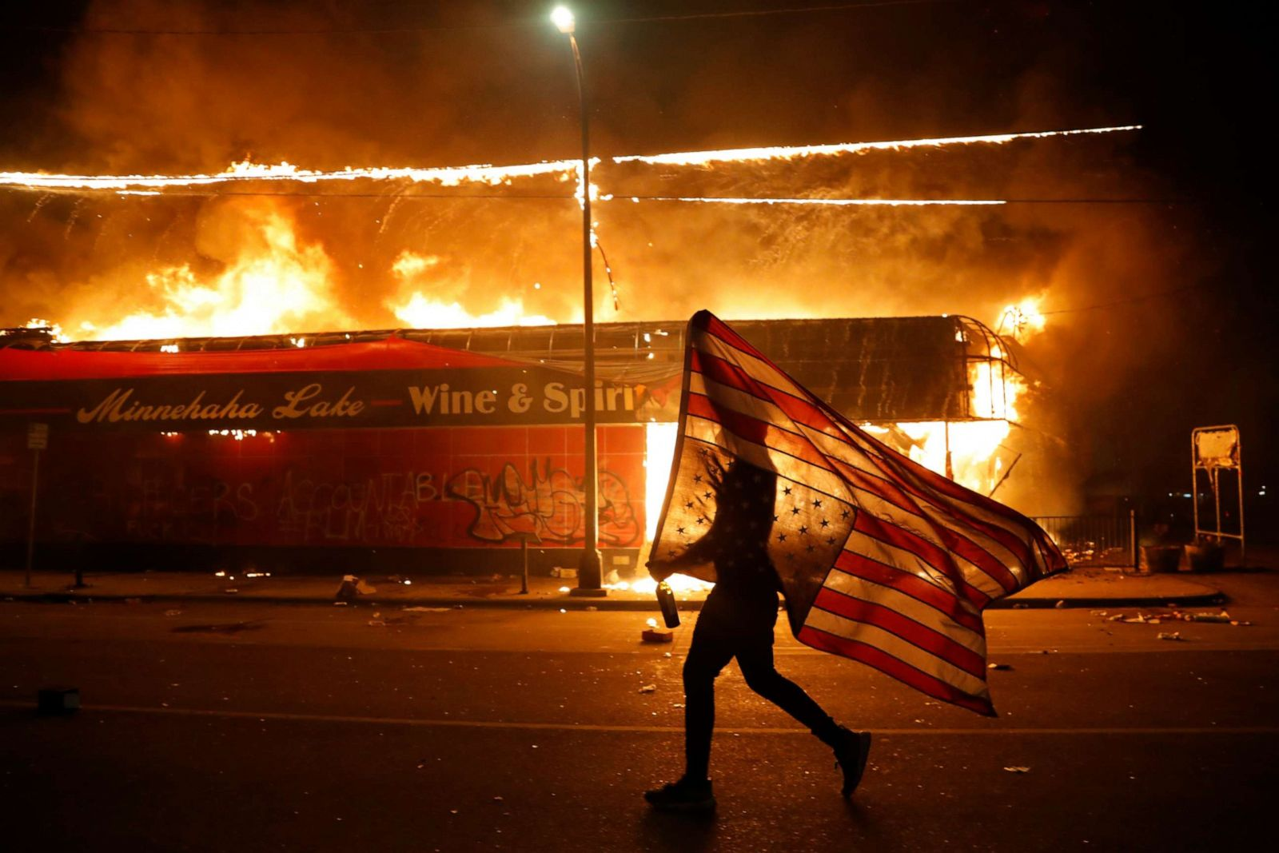
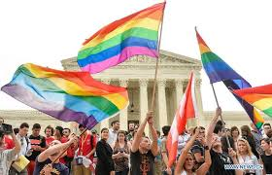
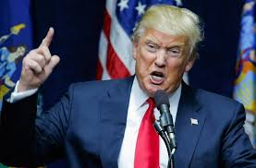
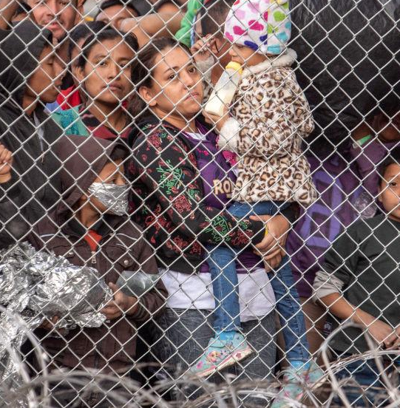
THE UNITED STATES IS FACING SOME OF THE GREATEST CHALLENGES ITS EVER FACED
SCOTUS HOLDS A LOT OF POWER IN DETERMINING OUTCOMES
SO MUCH SO, THAT SCOTUS BECAME A CENTRAL POINT OF THE 2020 ELECTION
Notes:
For some background into why this model is interesting and relevant:

Slide 4
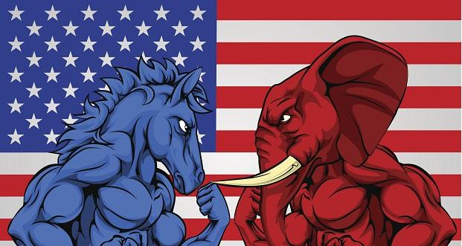
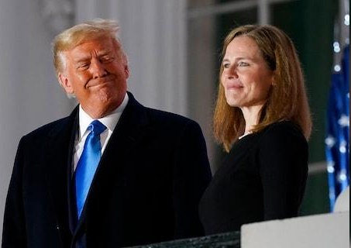
THE FIGHT OVER THE SUPREME COURT IS A BI- PARTISAN FIGHT
Associate Justice Amy Coney Barrett Sworn in October 27th, 2020
Notes:
Many people view the fight over the supreme court as one of differing interests in our bipartisan system
Just this year this fight has caused issues and criticism of large magnitude within the US Senate

Slide 5
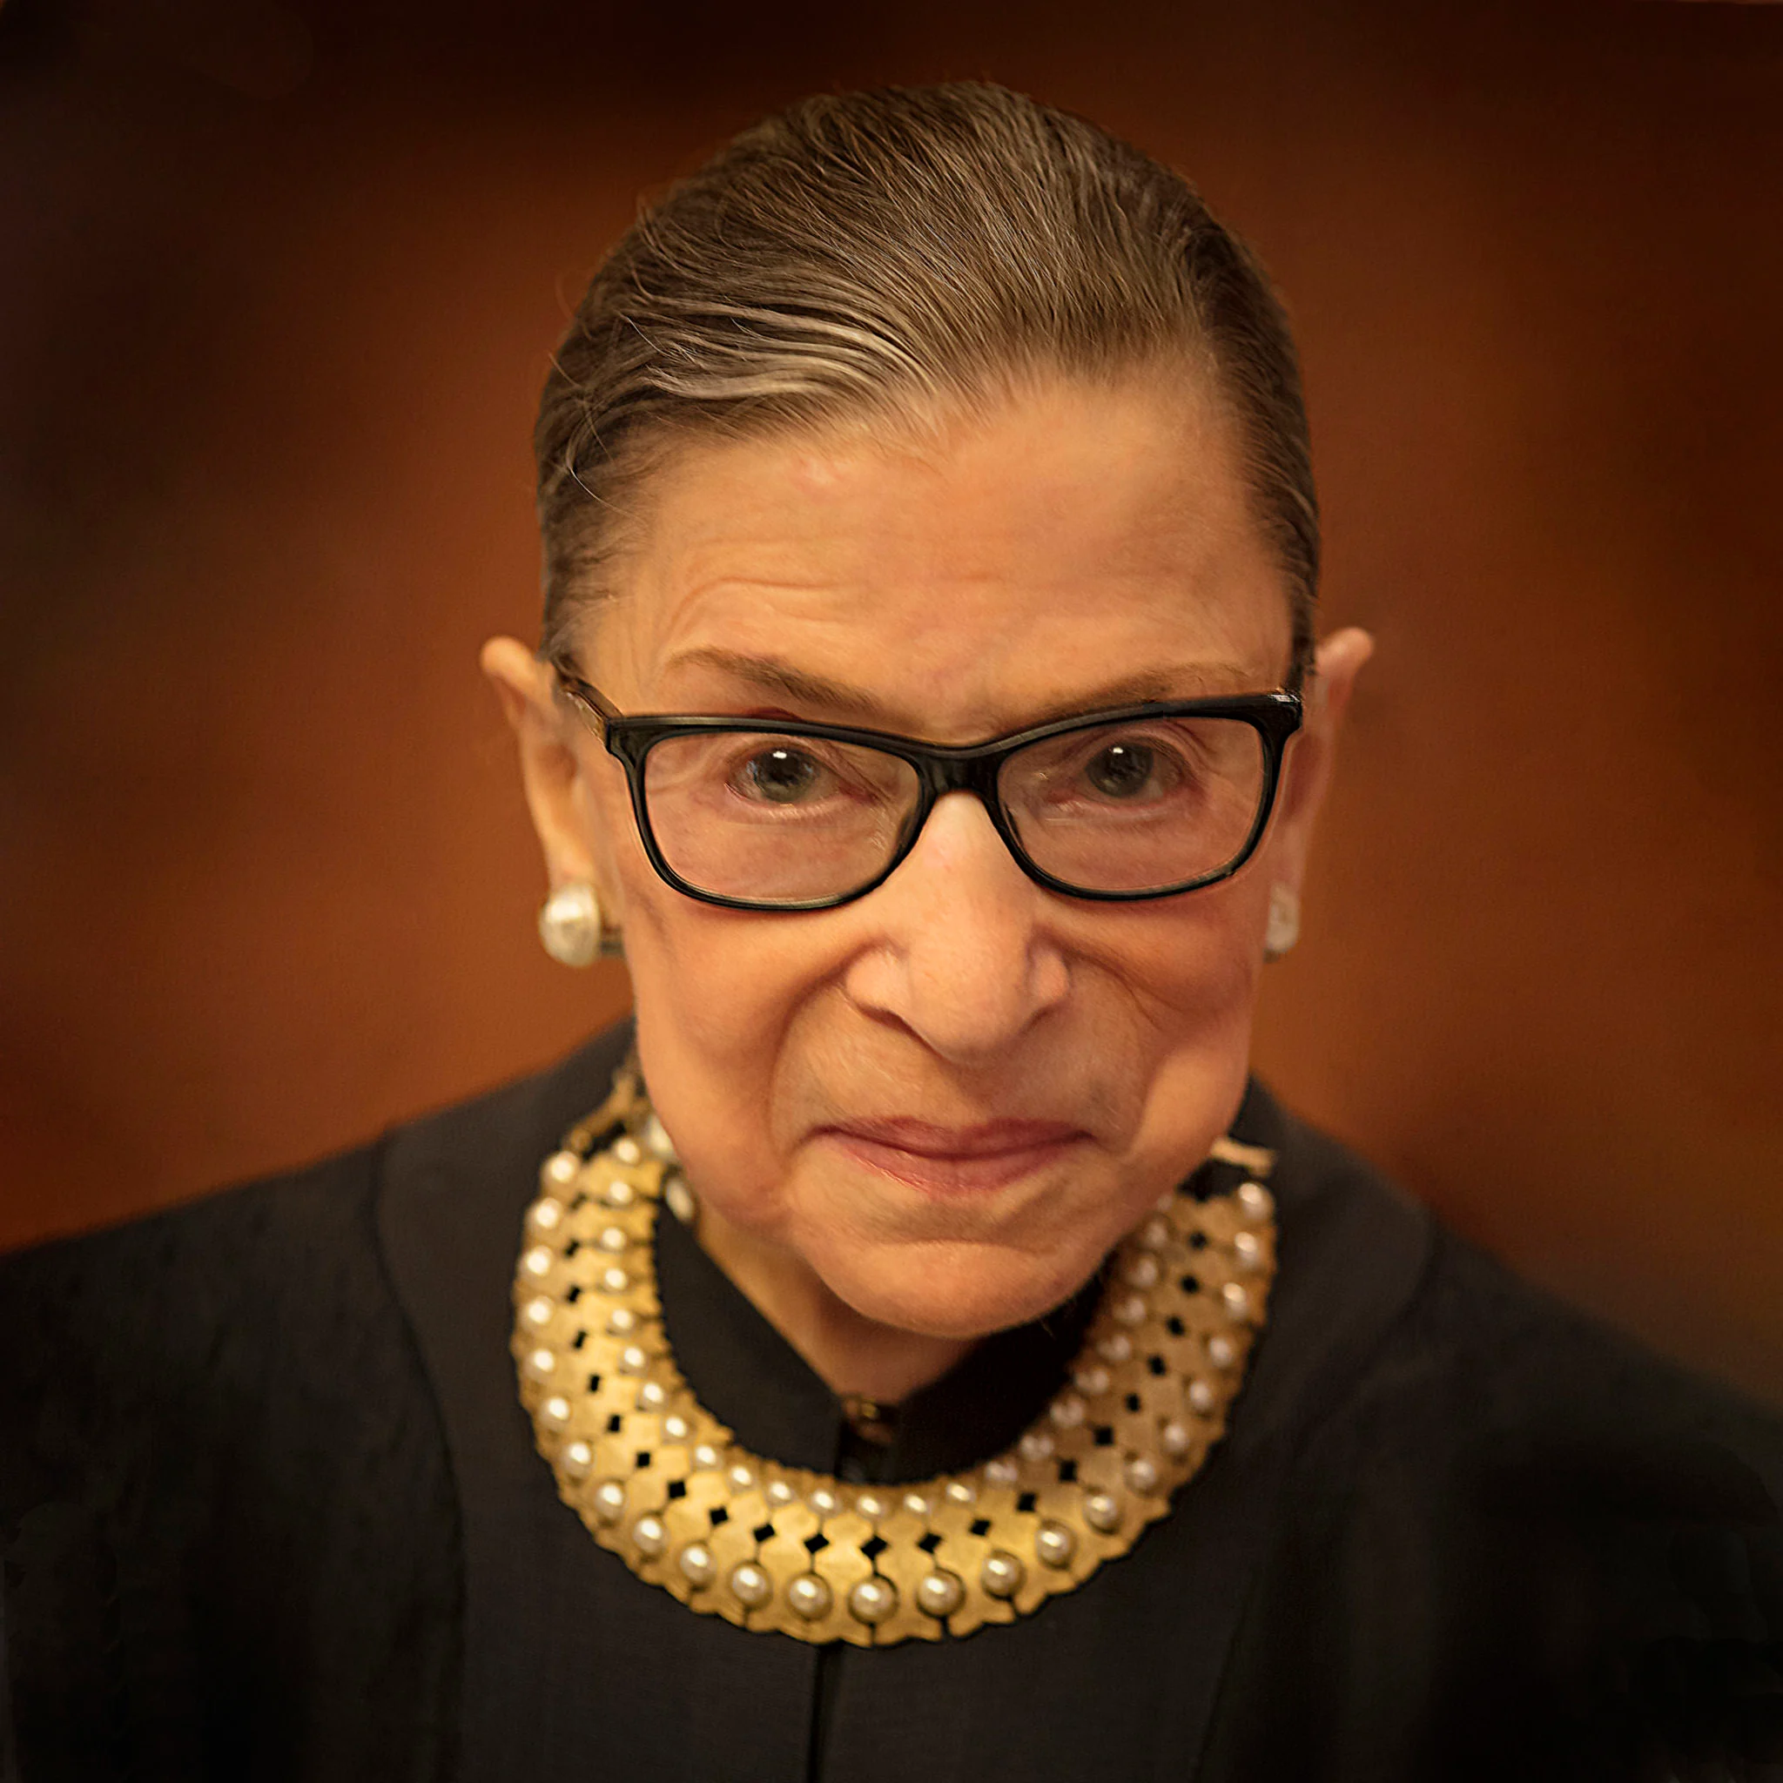
“[SCOTUS Justices]
aren’t politicians in robes”
T H E L A T E
RBG
VOTED ‘LIBERAL’
O N L Y
63%
OF THE TIME
Notes:
The bipartisan view of the court is often challenged however, with some saying that the SCOTUS Justices are not just politicians in robes, they are not simply pundits of the president who elected them, and some even say that some SCOTUS appointments may result in surprises for the appointing president.
Even the Liberal Icon Ruth Bader Ginsburg only voted ‘liberal’ 63% of the time.

Slide 6
WHY PREDICT THE LEAN
OF A JUSTICE’S VOTE?
Allow those with appointing powers to higher courts a way to predict how a judge will vote on certain issues
Help petitioners understand how a specific judge might vote on their issue
Allow media a data-based solution to understand the leanings of our supreme court justices
Provide a data-informed tool for the public
Notes:
Allow those with appointing powers to higher courts a way to predict how a judge will vote on certain issues, so that a person in power appointing a judge to any court can be fully aware of how that judge might vote on issues of consequence to them.
Help petitioners understand how a specific judge might vote on their issue, which could be a resource for them to frame and present the case in such a way as to move the judges in question to vote in their favor
Allow media a data-based solution to understand the leanings of our supreme court justices, and provide support in unbiased fact based reporting about the supreme court and issues therein.
Provide a data-informed tool for the public to be able to understand how the supreme court justices are voting on issues that are likely to deeply affect them.

Slide 7
FEATURES
TARGET
Term
Issue
Issue Area
Justice Name
Legal Provisions Considered by the Court
Declaration of Unconstitutionality
Decision Direction (Conservative or Liberal)
DIRECTION OF INDIVIDUAL JUSTICE’S VOTE
(Conservative or Liberal)
Notes:
1. In the context of issues pertaining to criminal procedure, civil rights, First Amendment, due process, privacy, and attorneys, liberal (2)=
pro-person accused or convicted of crime, or denied a jury trial
pro-civil liberties or civil rights claimant, especially those exercising less protected civil rights (e.g., homosexuality)
pro-child or juvenile
pro-indigent
pro-Indian
pro-affirmative action
pro-neutrality in establishment clause cases
pro-female in abortion
pro-underdog
anti-slavery
incorporation of foreign territories
anti-government in the context of due process, except for takings clause cases where a pro-government, anti-owner vote is considered liberal except in criminal forfeiture cases or those where the taking is pro-business
violation of due process by exercising jurisdiction over nonresident
pro-attorney or governmental official in non-liability cases
pro-accountability and/or anti-corruption in campaign spending
pro-privacy vis-a-vis the 1st Amendment where the privacy invaded is that of mental incompetents
pro-disclosure in Freedom of Information Act issues except for employment and student records
conservative (1)=the reverse of above
2. In the context of issues pertaining to unions and economic activity, liberal (2)=
pro-union except in union antitrust where liberal = pro-competition
pro-government
anti-business
anti-employer
pro-competition
pro-injured person
pro-indigent
pro-small business vis-a-vis large business
pro-state/anti-business in state tax cases
pro-debtor
pro-bankrupt
pro-Indian
pro-environmental protection
pro-economic underdog
pro-consumer
pro-accountability in governmental corruption
pro-original grantee, purchaser, or occupant in state and territorial land claims
anti-union member or employee vis-a-vis union
anti-union in union antitrust
anti-union in union or closed shop
pro-trial in arbitration conservative (1)= reverse of above
3. In the context of issues pertaining to judicial power, liberal (2)=
pro-exercise of judicial power
pro-judicial "activism"
pro-judicial review of administrative action
conservative (1)=reverse of above

Slide 8
JUSTICES INCLUDED:
Clarence Thomas
Ruth Bader Ginsburg (RIP)
Stephen Breyer
John Roberts
Samuel Alito
Sonia Sotomayor
Elena Kagan
Neil Gorsuch
Brett Kavanaugh
* Newest Associate Justice Amy Coney Barrett is not included as there is not enough data on her Supreme Court decisions yet.
Notes:
Justices included are all of the current justices of the supreme court, with the exception of Ruth Bader Ginsburg, who is included in her honor and due to her extensive contributions towards liberal ideology within the court, and Amy Coney Barrett, who is not include as there is not enough data on her supreme court decisions yet.

Slide 9
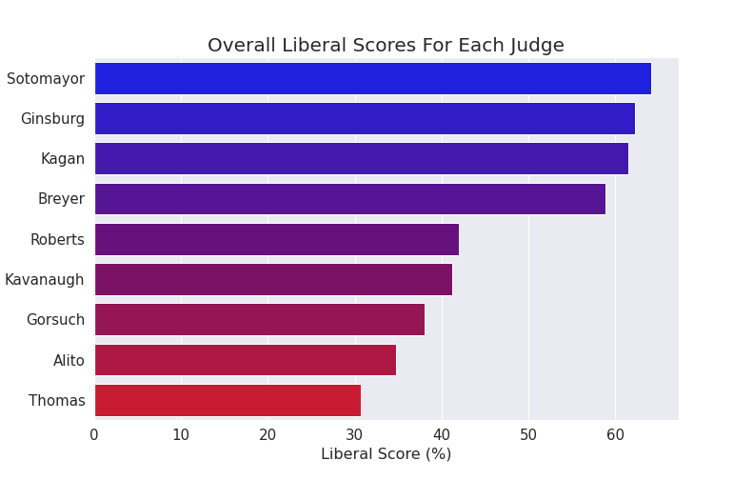
L I B E R A L
S C O R E
Notes:
In order to compare the differing leanings of these justices, I used the data to calculate their Liberal Score, which is a common measure used in analysis of courts. The ratio of their liberal leaning votes over all their votes is used to calculate their liberal score, which is the percentage of the time they have voted liberal.
As aforementioned and seen here, RBG only voted liberal 63 % of the time, however she is known as a liberal icon. Here we see that she clearly is one of the most liberal judges,
But in order to understand liberal and conservative it’s, both important and interesting to look at the issues areas in question and each justice’s liberal scores per issue area to get an understanding of why a model that looks at issues and predicts a judge’s vote is valuable.

Slide 10
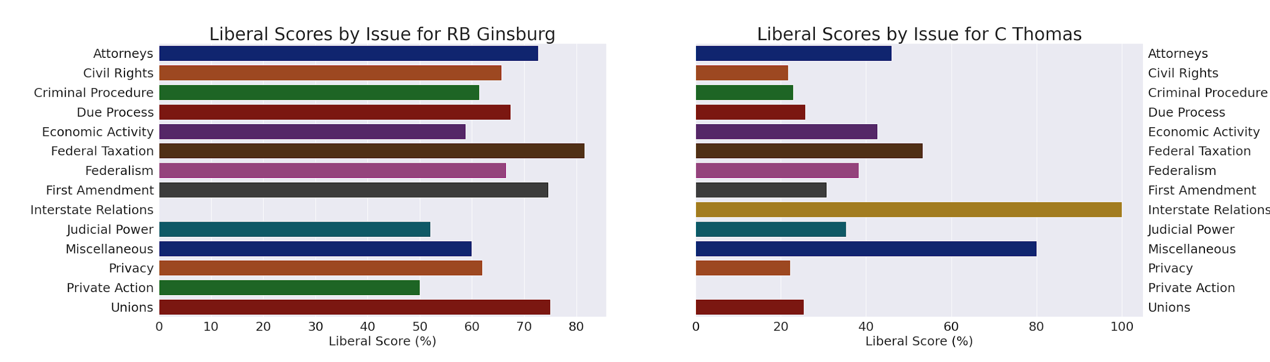
I S S U E A R E A S :
How does RBG compare to Clarence Thomas?
Notes:
Let’s compare our favorite liberal icon with the most conservative justice, Clarence Thomas.
MAJOR DIFFERENCES CAN BE FOUND IN ALMOST ALL AREAS, BUT PRIMARILY BETWEEN:
Civil Rights, Criminal Procedure, Due Process, Cases pertaining to the First Amendment, Privacy, and Unions
Also in Interstate Relations but in the exact opposite way, in that for the few cases voted on by Ginsburg and Thomas pertaining to Interstate relations, Ginsburg has always voted conservatively and Thomas has always voted liberally.
Interstate Relations:

Slide 11
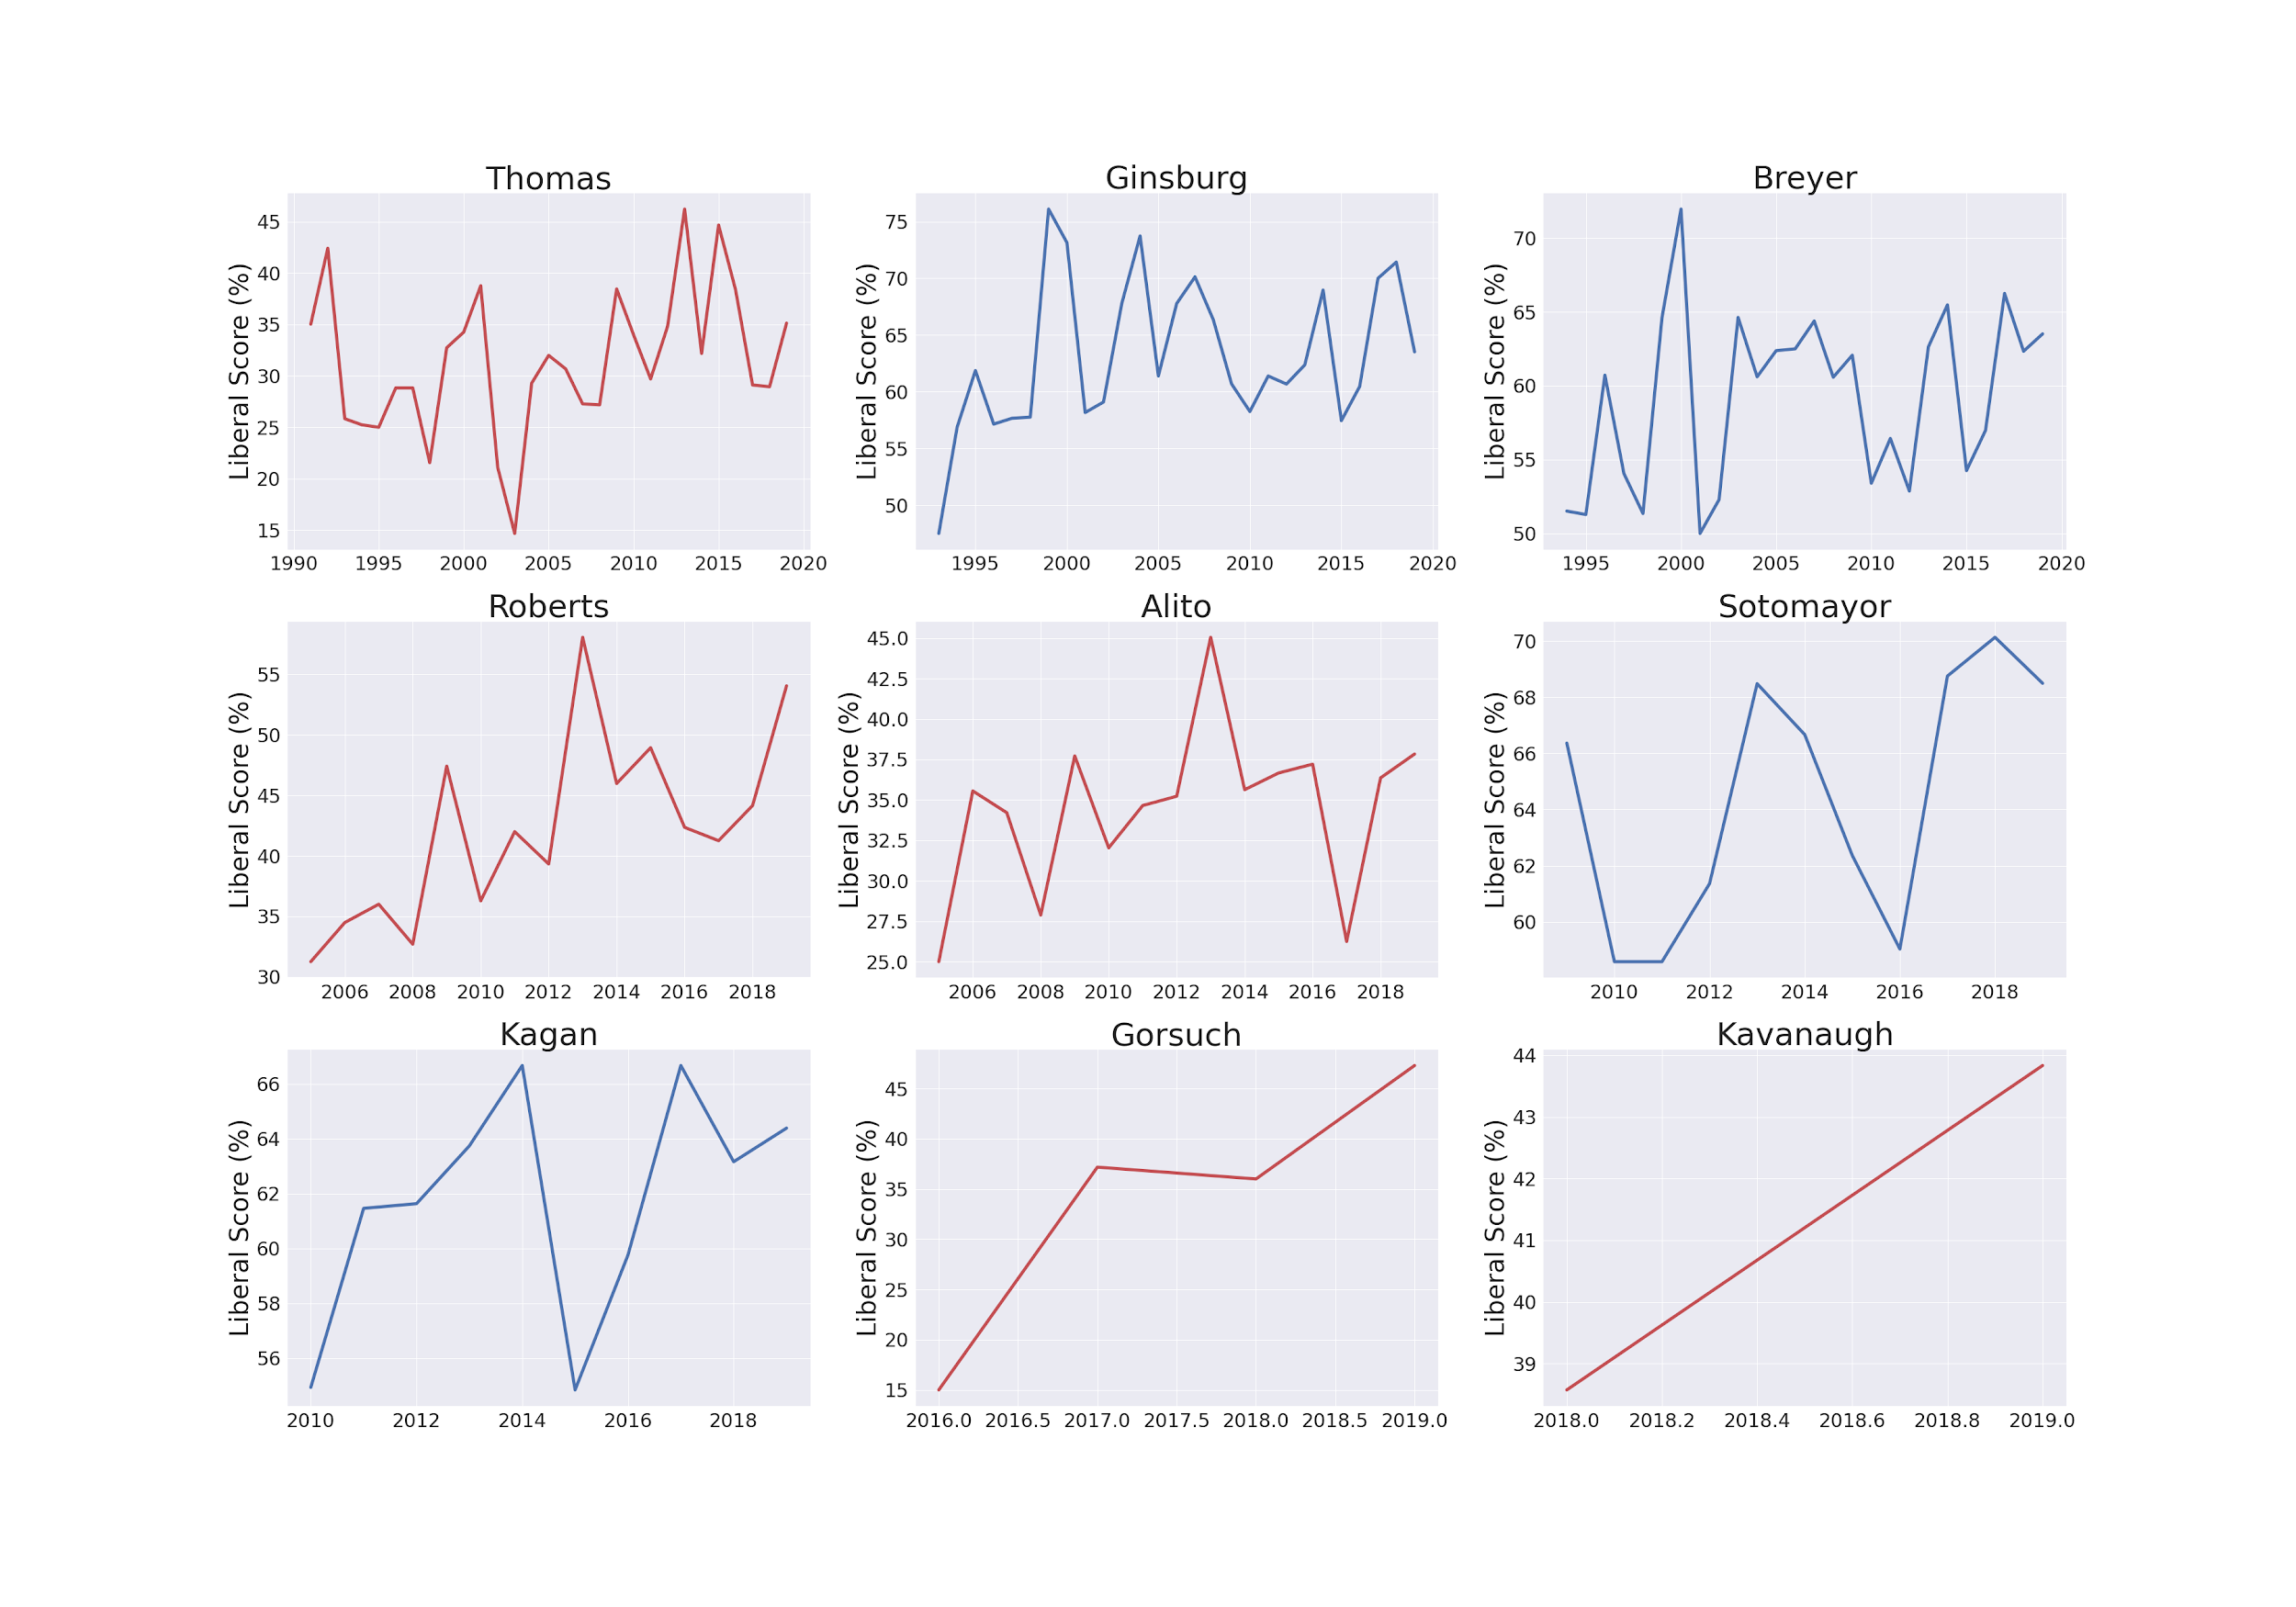
T E R M
Notes:
Certainly is a trend over time noticeable in almost all but Justice Thomas, in that most judges, even those considered conservative, have tended to vote more liberal over time, overall. This may have to do with which cases they saw in the given term year, and how that justice leans on that particular issue area, but overall it’s possible that term year may be a significant feature in predicting the lean of a justice’s vote.

Slide 12
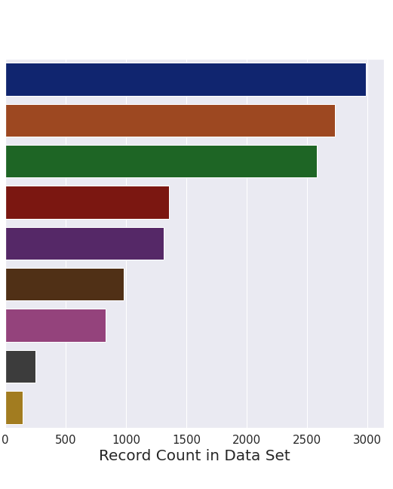
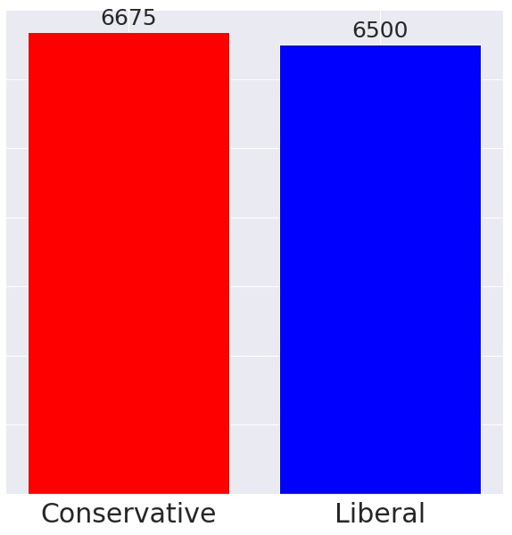
B A L A N C E O F T A R G E T C L A S S E S & F E A T U R E S
Thomas
Ginsburg
Breyer
Roberts
Alito
Sotomayor
Kagan
Gorsuch
Kavanaugh
RECORD COUNT PER JUSTICE
RECORD COUNT PER TARGET CLASS
Notes:
Thomas has been on the bench since 1991, and he will therefore have many more records than Kavanaugh who has been on the bench since 2017.
The target classes of conservative and liberal are balanced, so no major threat of dominant class bias.

Slide 13
A BRIEF LOOK AT THE PROCESS OF
EXPLORATORY DATA ANALYSIS:
Missing Values & Outliers in Dataset
14,366 records to 13,175 records after null dropped
Ranking All Features with Select K-Best
274 Features After One Hot Encoding
Chi-squared used to rank features in order of importance
Entire feature set performs better than limited feature set
Ratio of Records to Features
After One Hot Encoding:
13,175 : 274 → ~48 : 1
Notes:
There were some missing values in the chosen features, particularly the target variable, the justice’s direction of vote. As seen before, we calculated the justice’s liberal score and therefore know their tendencies. Even so, I chose not to fill in the target variable with these tendencies, in an effort for the model to be purely based on the judge’s actions and not based on any kind of tendency.
All of the features chosen are categorical variables, and therefore there is no distributions to be examined and therefore no outliers just by the nature of categorical variables.
After converting all categorical variables to dummy variables, there were 274 Features. In order to determine which variables are the most important, i used the Select K Best function from Scikit-learn, which employed the chi-squared test to determine which features are the most significant in explaining the outcome. Even after testing smaller feature sets based on the result of the chi-squared test, the entire feature set still performed better than any limited feature set.
This brings into question the ratio… with 274 features, is it too many? An acceptable ratio of records to features is considered to be 10:1 or 15:1. Even after conversion to dummy variables, the ratio of records to features in this model is still about 48:1, which is very appropriate.

Slide 14
MODELS USED:
Logistic Regression
Random Forest Classifier
K-Nearest Neighbors
Gradient Boosting Classifier
Notes:
The models I used in the process of determining the best ones are:
We’ll take a brief look at some of the statistics and tuning processes behind each of these four models.

Slide 15
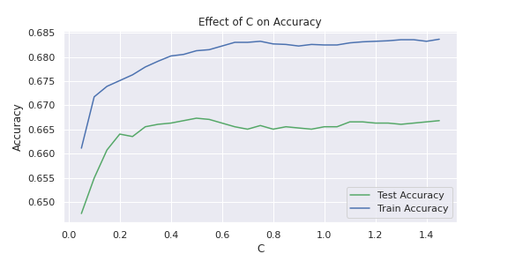
L O G I S T I C
R E G R E S S I O N
BEST PARAMS***
solver: ‘lbfgs’
C: 0.5
max_iter: 1000
TRAINING DATA
Accuracy: 0.6813
Precision: 0.6723
Recall: 0.6969
TESTING DATA
Accuracy: 0.6673
Precision: 0.6509
Recall: 0.6850
*** Searched for best parameters by comparing different solvers, and creating validation curves for C and max_iter
Notes:
First a look at logistic regression
The best parameters shown here were determined by comparing different solvers, and creating validation curves for the C parameter and the maximum iterations parameter. The only one of interest was C, from which C=0.5 was chosen, resulting in
TRAINING DATA
TESTING DATA

Slide 16
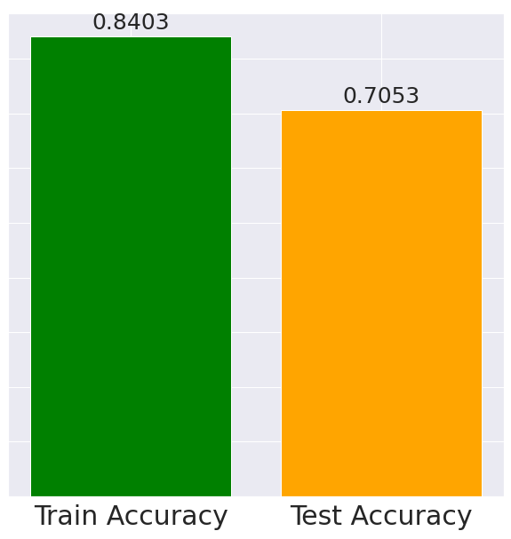
R A N D O M
F O R E S T
BEST PARAMS***
max_depth: 30
Max_features: ‘sqrt’
min_samples_leaf: 1
min_samples_split: 5
n_estimators: 400
TRAINING DATA
Accuracy: 0.8403
Precision: 0.8283
Recall: 0.8553
OVERFITTING
*** Searched for best parameters with Random Search and Grid Search CV
TESTING DATA
Accuracy: 0.7053
Precision: 0.6860
Recall: 0.7291
Notes:
The following parameters for the Random Forest model were found using an extensive and computational expensive process of Random Search and multiple Grid Search Cross Validation processes, which finally resulted at these parameters, which produced a model with scores that to be honest are not much better than the base, default model.
TRAIN SCORES 84!
BUT TEST SCORE… 70
Which is a clear situation of overfitting, of which the Random Forest model is prone to do, and for which I could not find any parameters that prevented this from occurring.

Slide 17
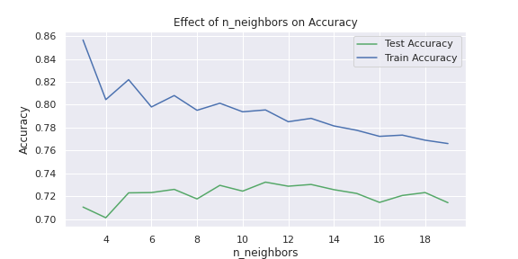
K - N E A R E S T
N E I G H B O R S
BEST PARAMS***
n_neighbors:
18
TRAINING DATA
Accuracy: 0.7690
Precision: 0.7867
Recall: 0.7330
TESTING DATA
Accuracy: 0.7232
Precision: 0.7867
Recall: 0.6803
*** Searched for best parameters with validation curve of k-neighbors

Slide 18
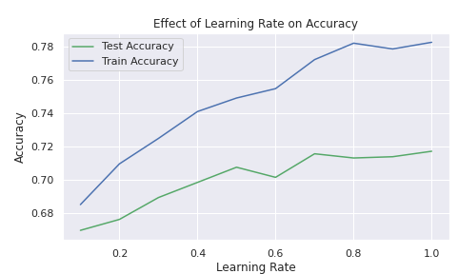
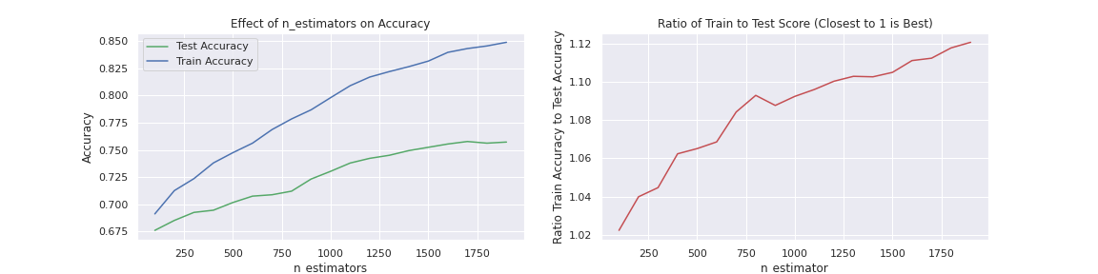
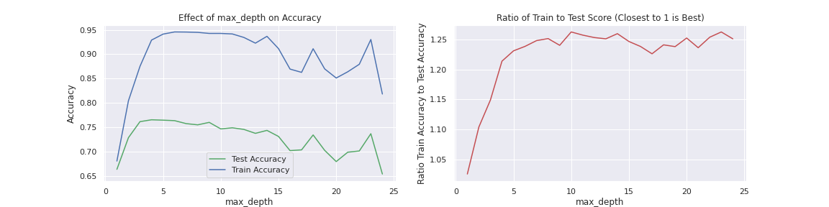
G R A D I E N T
B O O S T I N G
BEST PARAMS***
loss: ‘deviance’
learning_rate: 0.3
n_estimators: 1500
max_depth: 2
default params for remaining
TRAINING DATA
Accuracy: 0.8314
Precision: 0.8241
Recall: 0.8391
TESTING DATA
Accuracy: 0.7521
Precision: 0.7395
Recall: 0.7587
*** Searched for best parameters with validation curves for:
learning_rate
n_estimators
max_depth
subsample
min_samples_split
min_samples_leaf
Notes:
These are the final parameters determined for the best gradient boosting classifier model,
Determined by examining validation curves for many variables, the most interesting of which are learning rate, n_estimators, and max_depth. The others simple produced drastically diminishing results for any variation away from the default.

Slide 19
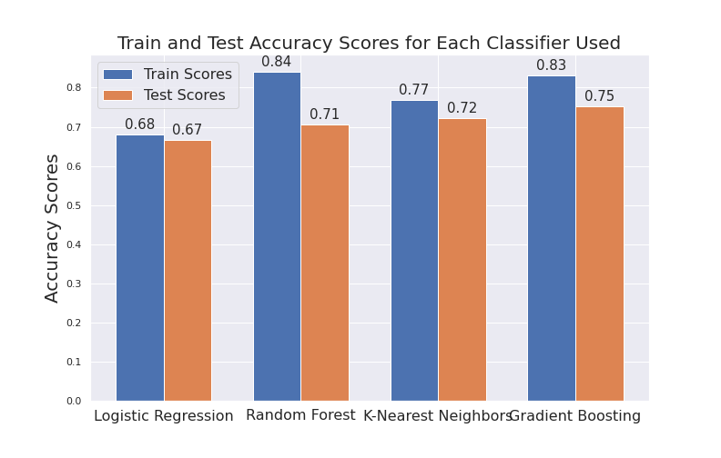
M O D E L C O M P A R I S O N :
GRADIENT BOOSTING CLASSIFIER
FOR THE WIN!
SURPRISE SURPRISE.
Notes:
The Gradient Boosting Model clearly has the highest test accuracy, and although it is just barely not the highest training accuracy, this is a testament to less overfitting of the Gradient Boosting Model compared to the Random Forest Model.
The Gradient Boosting Classifier is therefore the final model chosen to model this information and predict the outcome.
75% is a reasonably high accuracy in predicting the judge’s vote direction. As they say, good enough, or ideally in this case better, than government work.

Slide 20
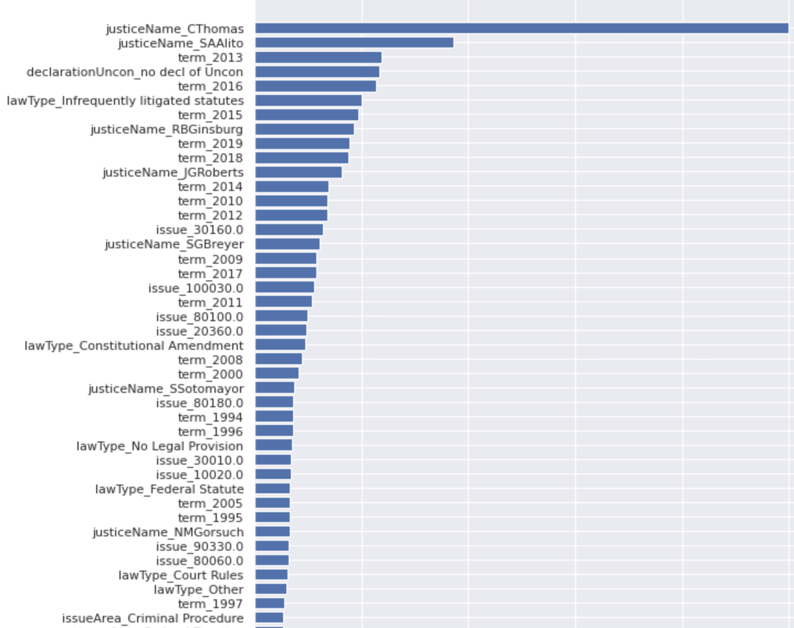
F E A T U R E
I M P O R T A N C E :
Justices with a higher record count are considered more important than other features
Certain ‘Term’ years are considered important
TOP 3 OTHER:
Declaration of Unconstitutionality
Infrequently Litigated Statutes
Constitutional Amendments
TOP 5 ISSUES:
Free Exercise of Religion
Federal Preemption of State Legislation or Regulation
State or Local Government Tax
Indigents: The US Supreme Court Docketing Fee
Patents and Copyright: Patents
Notes:
As predicted, the certain justices with a higher record count are considered more important than other features.
Additionally, as predicted, certain terms are considered more important, suggesting that there may be a trend in voting patterns over time with certain justices.
Top 3 Feature Importances besides Justice and Term year are
1. Whether or not there is a declaration of Unconstitutionality, which may be predicted
2. Interestingly, whether the statute that is being litigated has been argued infrequently.
3. Decisions made considering a Constitutional Amendment as the deciding factor in the case.
TOP 5 ISSUES:
1. Free Exercise of Religion
2. Federal Pre-Emption of State Legislation or Regulation
3. State or Local Government Tax
4. Indigents: US Supreme Court Docketing Fee
5. Patents and Copyright: Patents
These top features and issues can be interpreted as issues that see a large scale of divisiveness between the conservative and liberal rulings, and therefore these issues are valuable features in determining which direction a judge will vote an issue.
In this bar plot of relative importance, you see that justice Clarence Thomas is at the top, followed by Alito, indicating that the model considered these justice’s rulings most in predicting the outcomes, but this is not the extent of this bar, as you can see here, the relative importance of everythign else pales in comparison to the importance of whether or not the justice is Clarence Thomas. This is indicative of a possible limitation of the model and a bias of a dominant class of the justiceName feature.

Slide 21
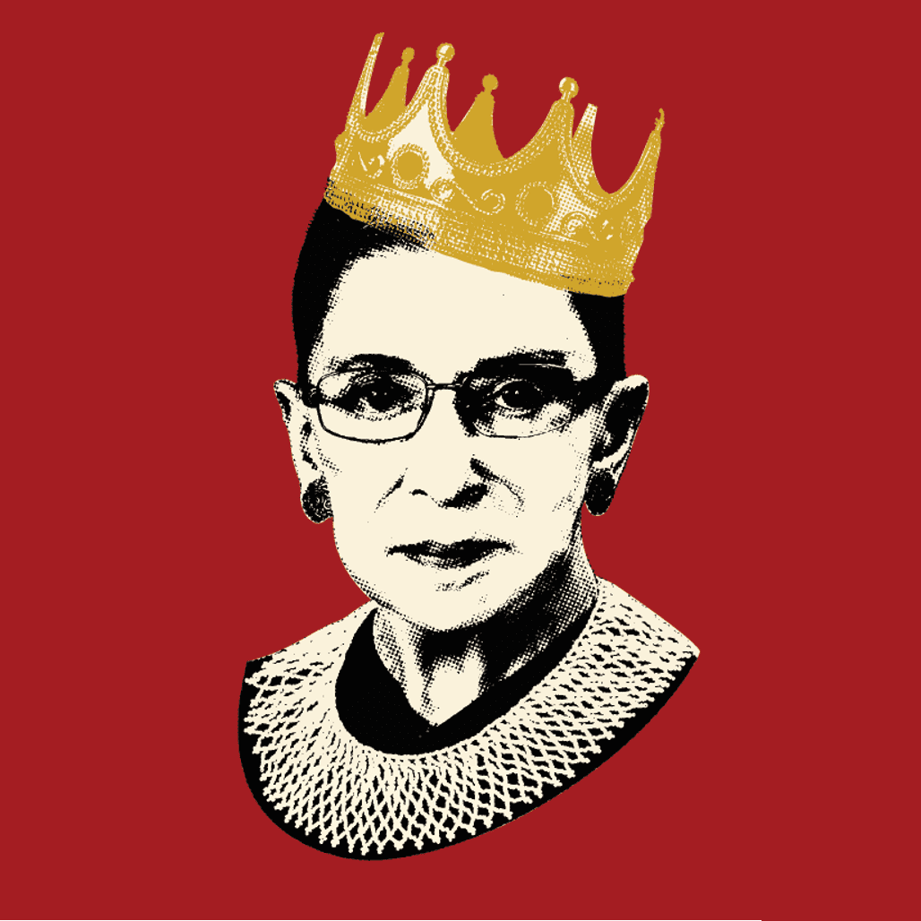
F U T U R E
D E V E L O P M E N T :
Model generalized for use by lower courts and with records of SCOTUS prospectives
Model could be used for a deeper dive on exploring metrics for individual issues of interest
Model altered to determine how RBG would have voted on future cases

Slide 22
T H A N K Y O U
Q U E S T I O N S ?
Supreme Court Database:
http://supremecourtdatabase.org/about.php
Courtesy of Washington University Law
Notes:
Thank you so much for attending this presentation on my Supervised Learning Capstone Project, I’ll now open the floor for comments and questions.

